Slide 1
1. Introduction to Knowledge Graphs
John P. McCrae
CT5166

Slide 2
Course Organisation

Slide 3
Course structure
9th Sep | Introduction to Knowledge Graphs | 21st Oct | Inductive reasoning
16th Sep | Models for Knowledge Graphs | 28th Oct | KG Creation (no lab on Monday)
23rd Sep | Querying and Serialization | 4th Nov | KG Alignment
30th Sep | Schemas | 11th Nov | Publishing and Linked Open Data
7th Oct | Deductive reasoning | 18th Nov | Linguistic Linked Open Data
14th Oct | No Lecture | 25th Nov | Enterprise Knowledge Graphs

Slide 4
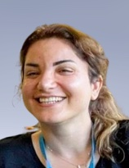

Labs
Labs will take place on Mondays 9-11 am
Lab tutors:
Samira Korani
Shubhanker Banerjee
Samira Korani
Shubhanker Banerjee

Slide 5
Assessment
Two assignments account for 20% of the mark each (40% total)
Assignment 1: Released 12th September, due 10th October
Assignment 2: Released 14th October, due 4th November

Slide 6
Exam
Exam will be standard written exam
There is one past paper, plus an extra “mock” paper that I will release.
Some material in this course is based on previous module DER5101

Slide 7


Course textbooks
Hogan et al., Knowledge Graphs. Free at https://kgbook.org/
Pan et al., Exploiting Linked Data and Knowledge Graphs in Large Organizations
Available at NUI Galway Library

Slide 8
Knowledge Graphs

Slide 9

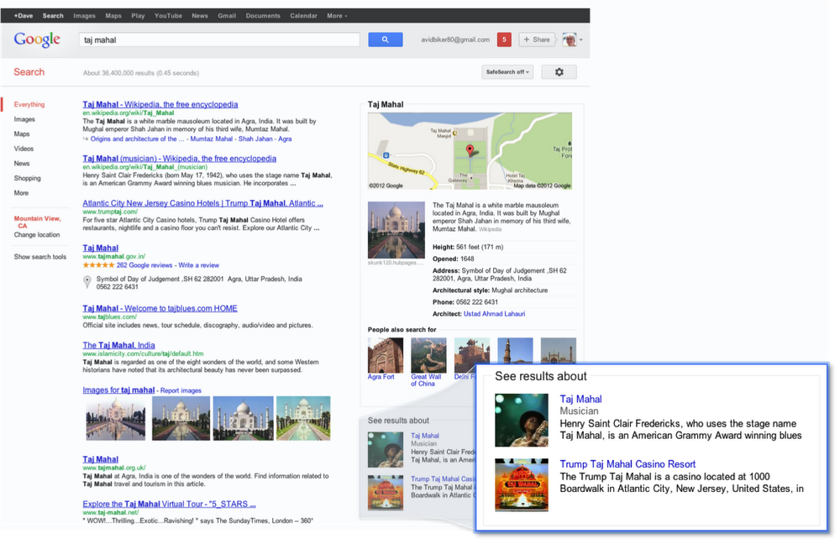
Things, not strings
Taj Mahal
blah blah blah Taj Mahal blah blah blah
blah blah blah Taj Mahal blah blah blah
blah blah blah Taj Mahal blah blah blah
Read https://blog.google/products/search/introducing-knowledge-graph-things-not/

Slide 10


Slide 11








Many other companies use knowledge graphs and term has been in use in academia since the 1970s

Slide 12





Many public, academic, domain and enterprise knowledge graphs are used in applications

Slide 13
What is a Knowledge Graph?
Ireland
locatedIn
Galway
memberOf
EU
Knowledge graphs use graphs to represent data

Slide 14
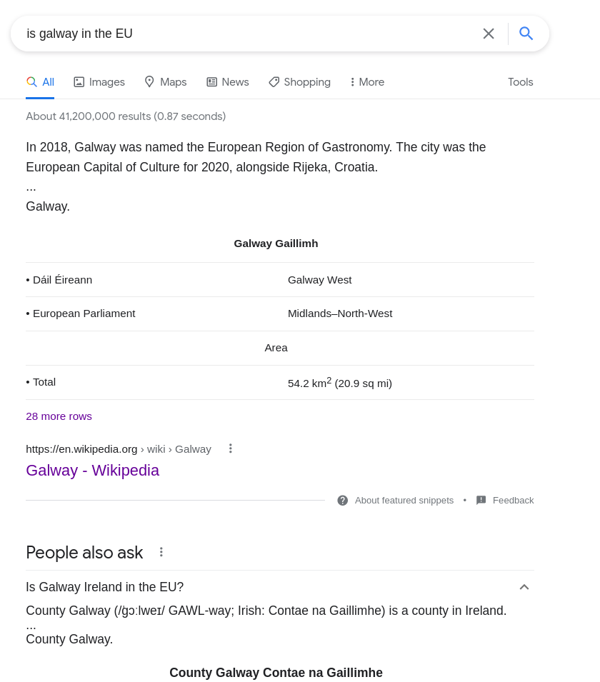
Is Galway in the EU?

Slide 15
Find a query that Google can’t answer
How can a knowledge graph answer this question?

Slide 16
Knowledge Representation

Slide 17
Alternatives: Relational Databases
Name | EU Member | Population
UK | False | 67.2 million
Ireland | True | 5.0 million
Germany | True | 83.2 million
Name | County | Country
Dublin | Dublin | Ireland
Galway | Galway | Ireland
Lisburn | Antrim | UK
SELECT * FROM city
WHERE city.name=”Galway” AND country.eu_member=true
JOIN countries ON city.country=country.name

Slide 18
Relational model
Very fast to query
Schema cannot change
Hard to navigate, visualize and write queries

Slide 19
Alternatives: Document Stores
{
“name”: “Ireland”,
“euMember”: true,
“cities”: [
“Dublin”,
“Galway”,
“Cork”
]
}
{
name(euMember: true),
cities(contains: “Galway”)
}

Slide 20
NoSQL Document Store
Relevant data stored together
Schema can evolve quickly
Hard to join data from different sources

Slide 21
Why use a knowledge graph?
Integrate knowledge from different sources
Fast-evolving data representation requirements
Enables powerful reasoning techniques

Slide 22
The Semantic Web
↓
Linked Data
↓
Knowledge Graphs

Slide 23
What is the Semantic Web?
The Semantic Web will bring structure to the meaningful content of Web pages, creating an environment where software agents roaming from page to page can readily carry out sophisticated tasks for users.
Tim Berners-Lee, “The Semantic Web”
Scientific American
Read this article: https://www.jstor.org/stable/pdf/26059207.pdf?casa_token=GZ3Nf23p7pYAAAAA:mv47zmWzLguTzP9hWXNgiS9Gj0cCN9cZR_Xqs05Mc83qbeBmFBkdkU_l1AYK2BTVx-NXBpH2OJ9I-7IwrO1raRJznnei-dOTNZDt0sgV7BmBO7rB5no

Slide 24

The Semantic Web is …
… Tim Berners-Lee’s vision of the future?

Slide 25

The Semantic Web is …
… artificial intelligence applied to the web?

Slide 26
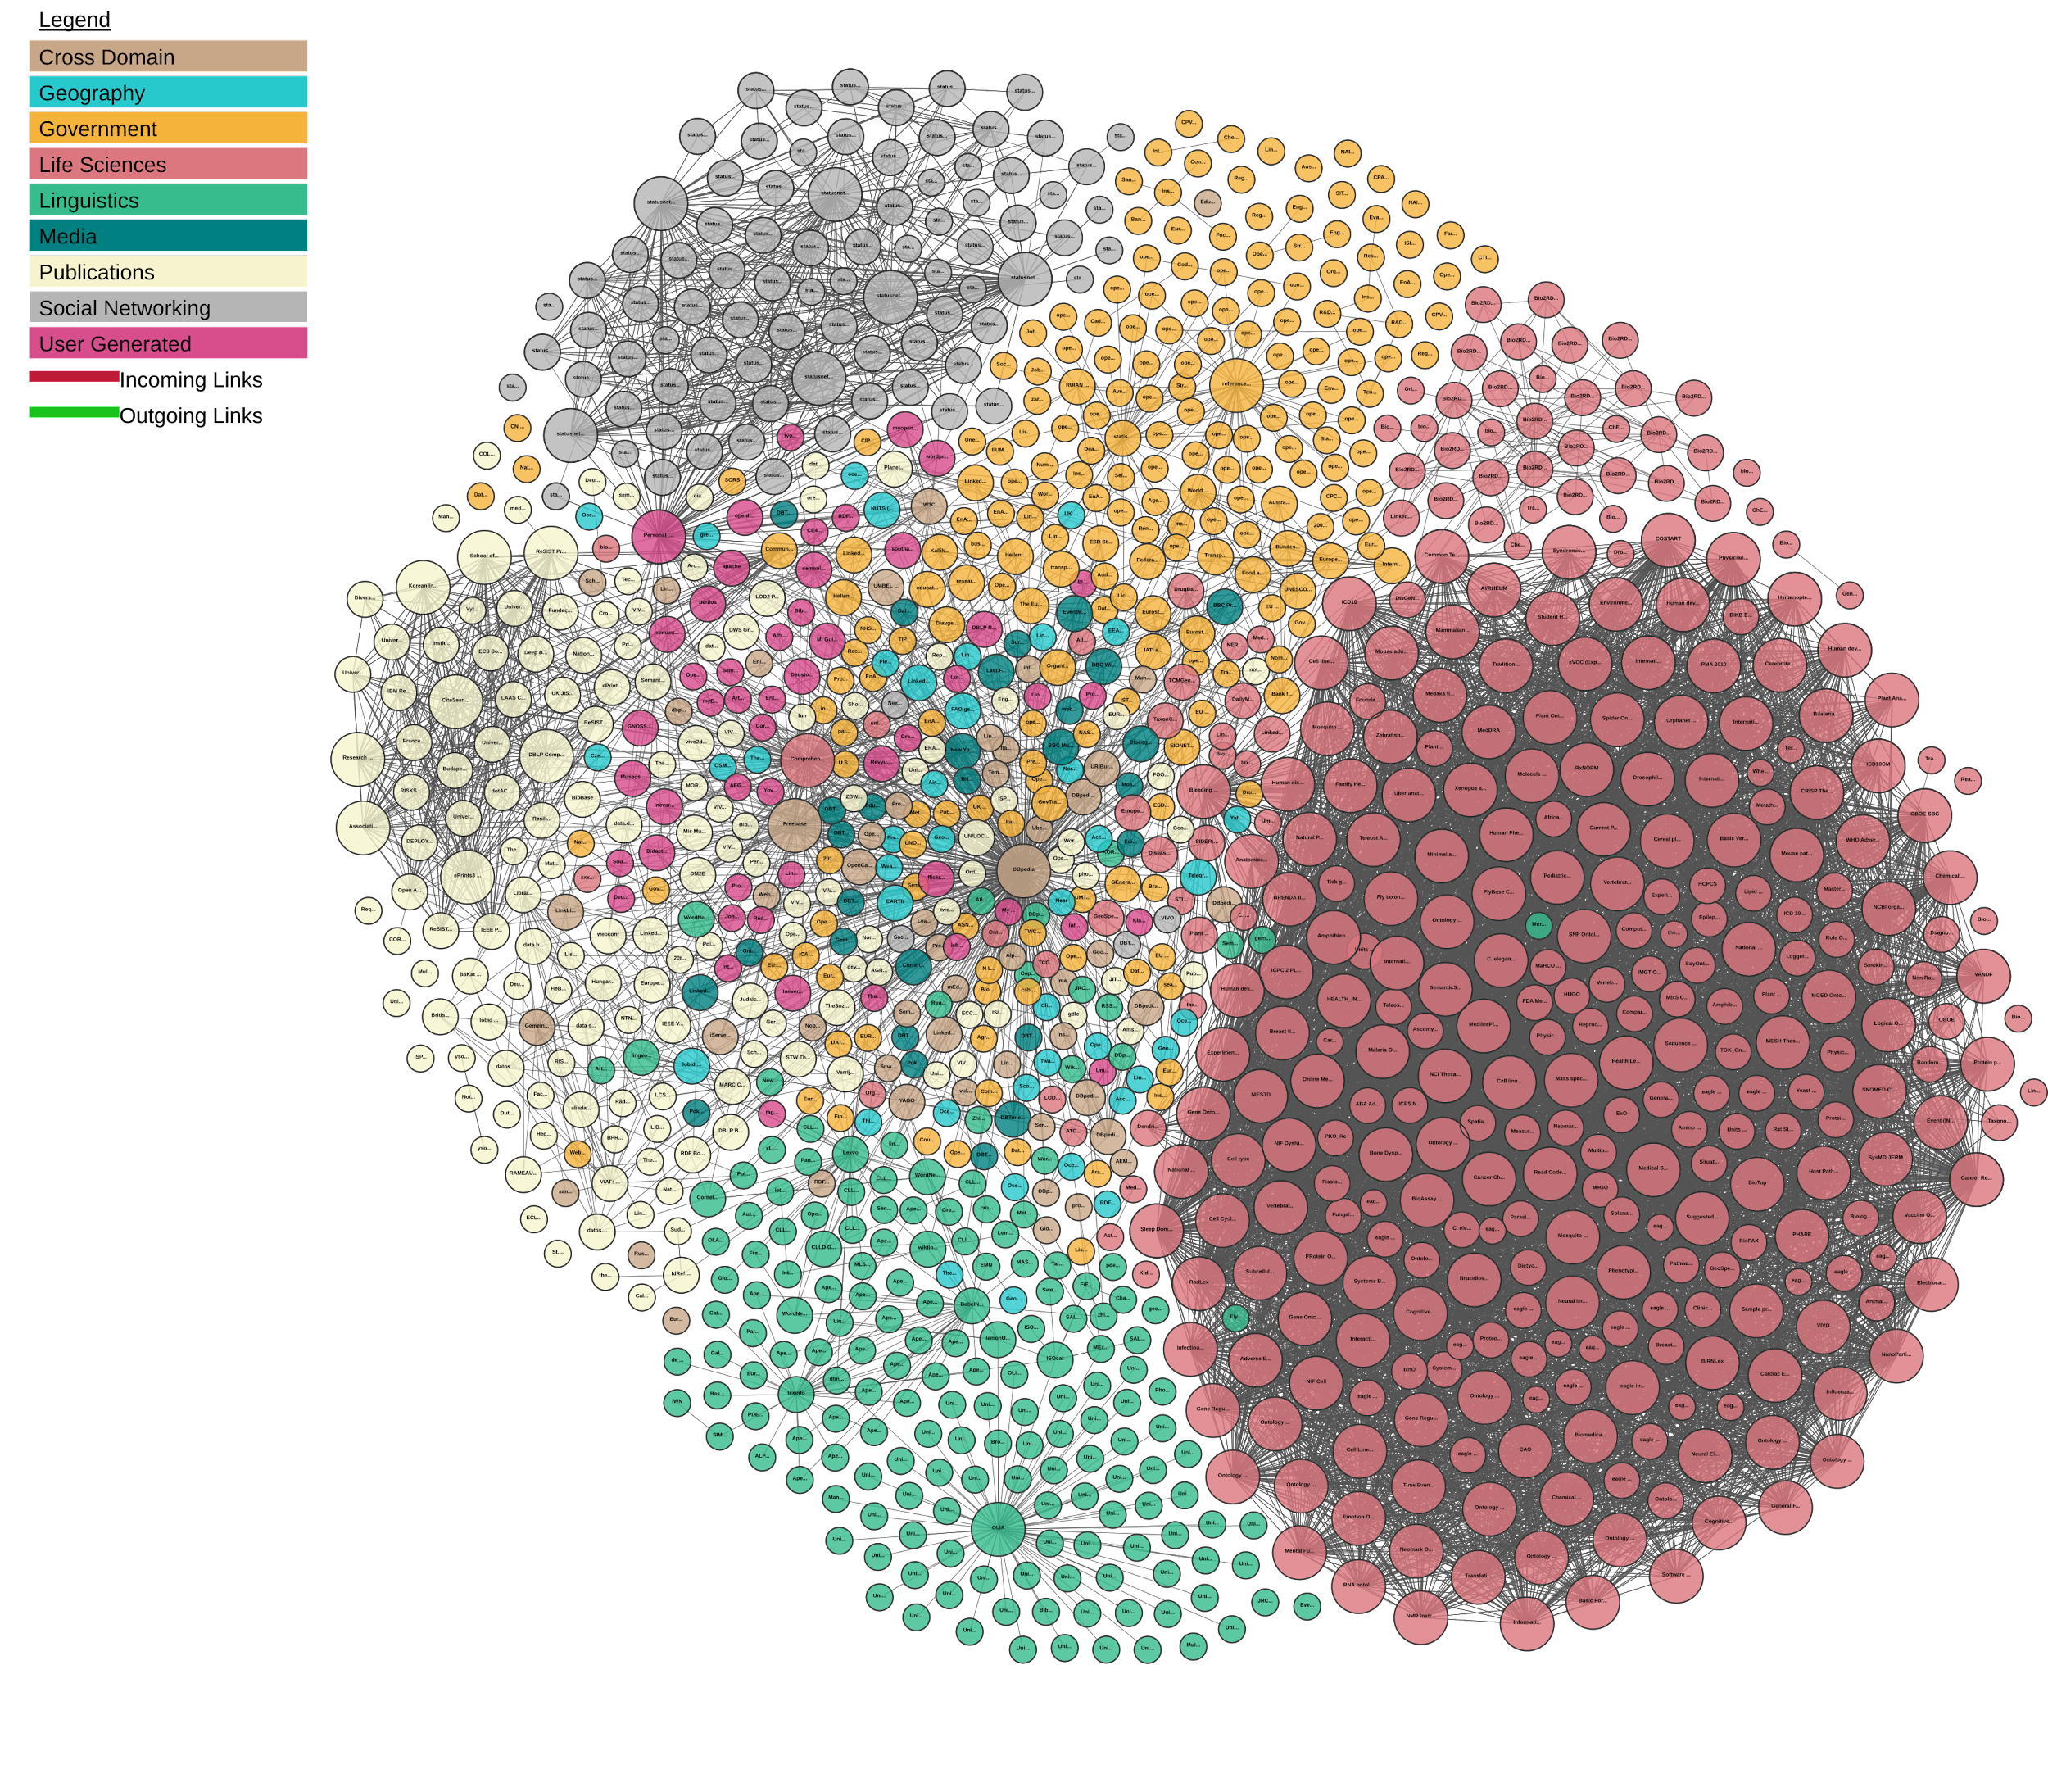
The Semantic Web is …
… links between open datasets?

Slide 27
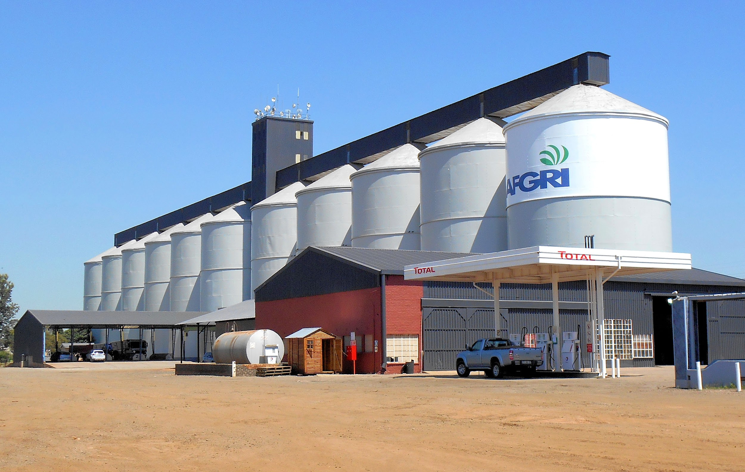
The Semantic Web is …
… breaking down data silos?

Slide 28
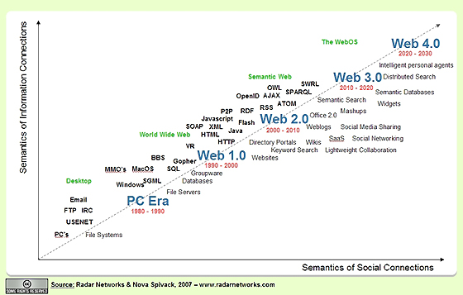
The Semantic Web is …
… web 3.0?

Slide 29

The Semantic Web is …
… a research area?

Slide 30

The Semantic Web is …
… an overhyped, outdated buzzword?
The Semantic Web

Slide 31
Knowledge Graphs
Linked Data
The Semantic Web

Slide 32
ALL OF THE ABOVE

Slide 33

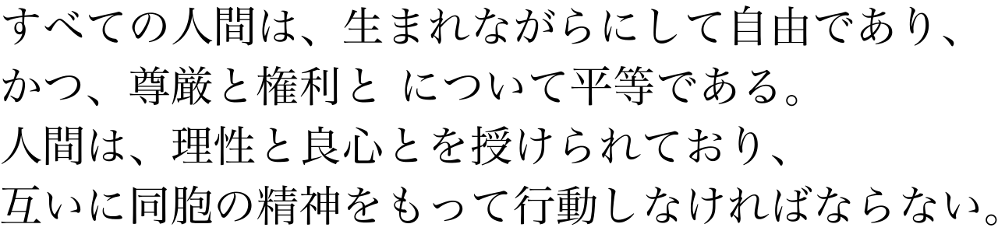
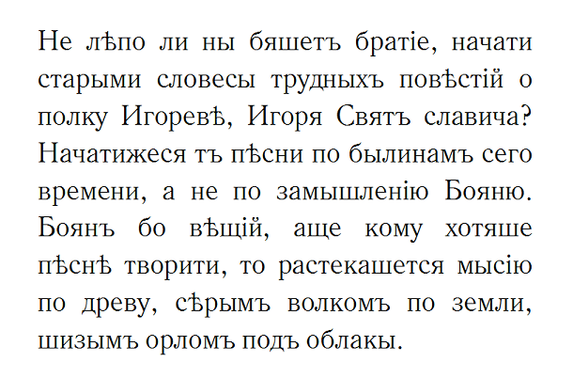
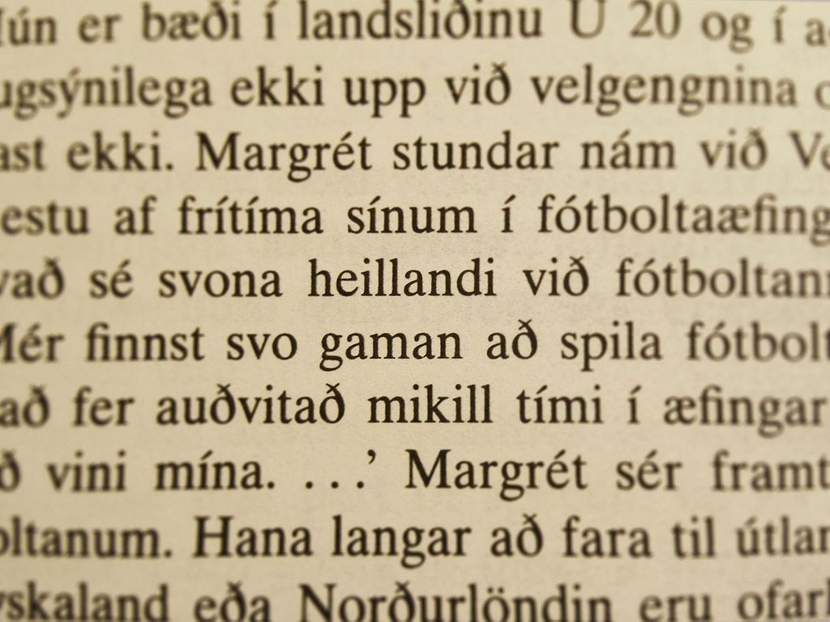
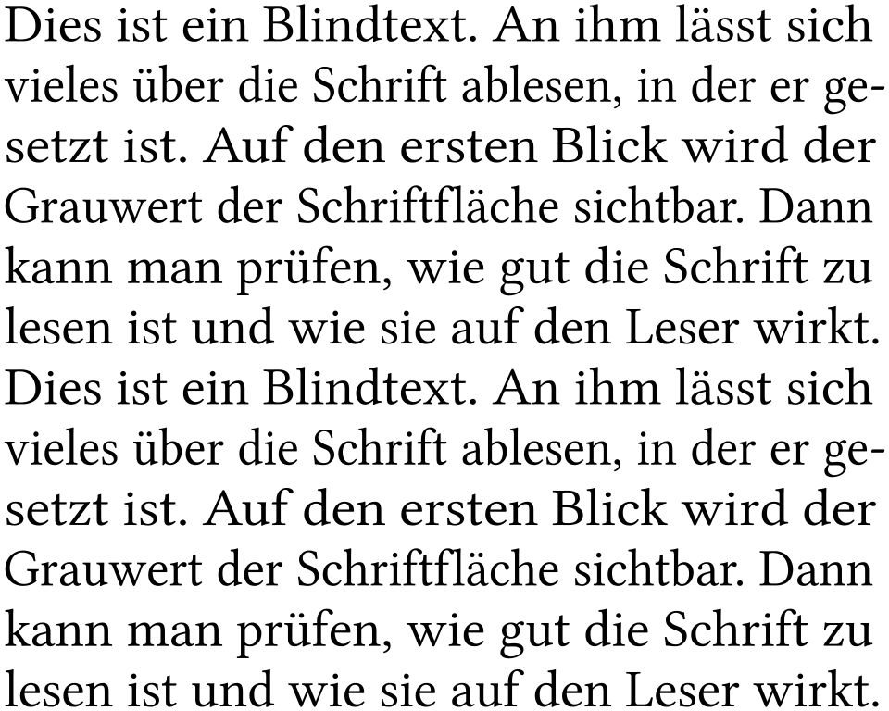

The current web
NLP?
Text
Artificial Intelligence

Slide 34

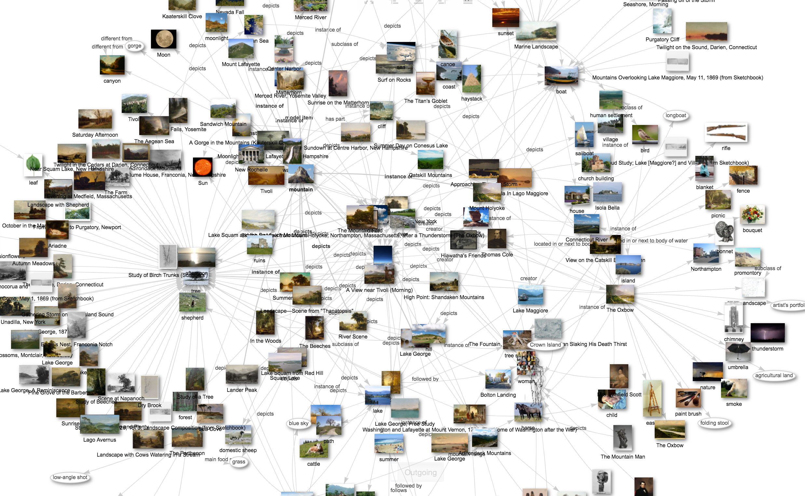

The Semantic Web
Semantic Data
Artificial Intelligence

Slide 35
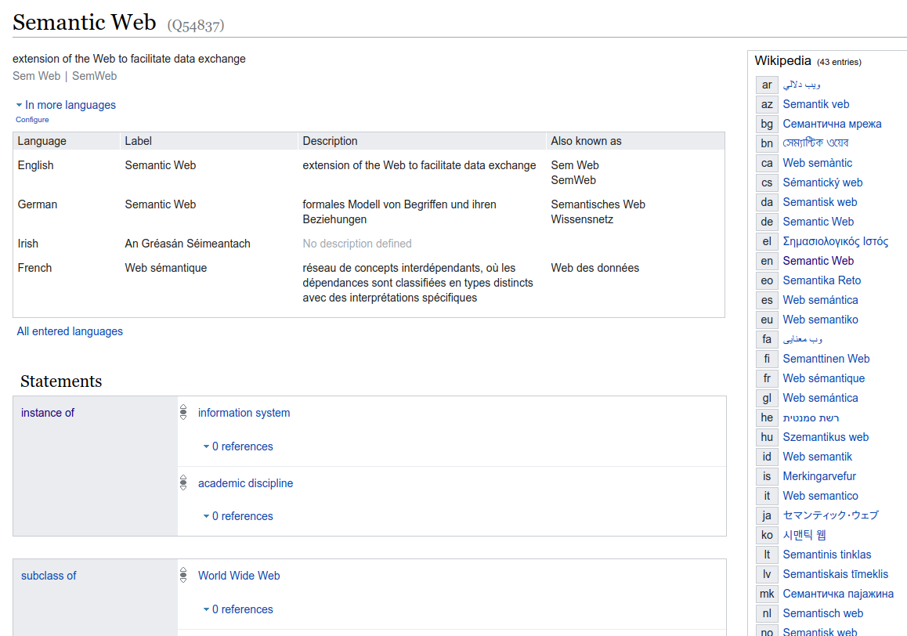

Structured Data

Slide 36
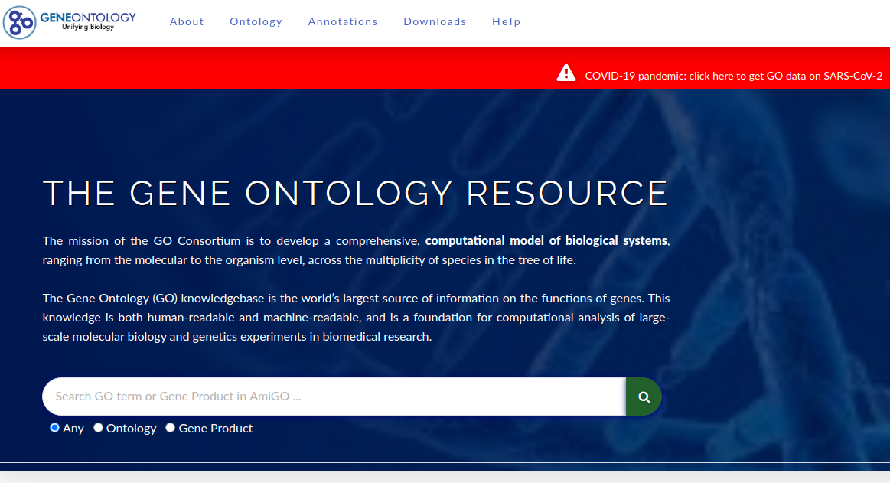
Structured Data

Slide 37
Discussion
Have you heard of the “Semantic Web” before?
What do you think of it?

Slide 38
Course Learning Outcomes

Slide 39
Models and Querying
RDF Data Model
<Ireland> a <Country> ;
<memberOf> <EU> .
<Galway> a <City> ;
<locatedIn> <Ireland> .
ASK {
<Galway> <locatedIn> [
<memberOf> <EU> ]
}
SPARQL Query

Slide 40
Logic and Inference
Co Galway
Ireland
Tuam
locatedIn
locatedIn
memberOf
EU
locatedIn?
Deductive approaches (rules)
Inductive approaches (machine learning)

Slide 41
Knowledge Graph Creation
Knowledge Graph
External Knowledge
Text Corpora

Slide 42
Knowledge Graphs in Application
Knowledge Acquisition
Knowledge Consumption
Understanding
Quality Assurance
Entity Summary
Ontology Development
Graph Summary
Exploitation
Data Linking
Semantic Search
Data Lifting
Query Generation
Question Answering
Knowledge Storage

Slide 43
Questions?

